Slide 1


UNIT 7:
On top of the world
Be what you want
to be

Slide 2
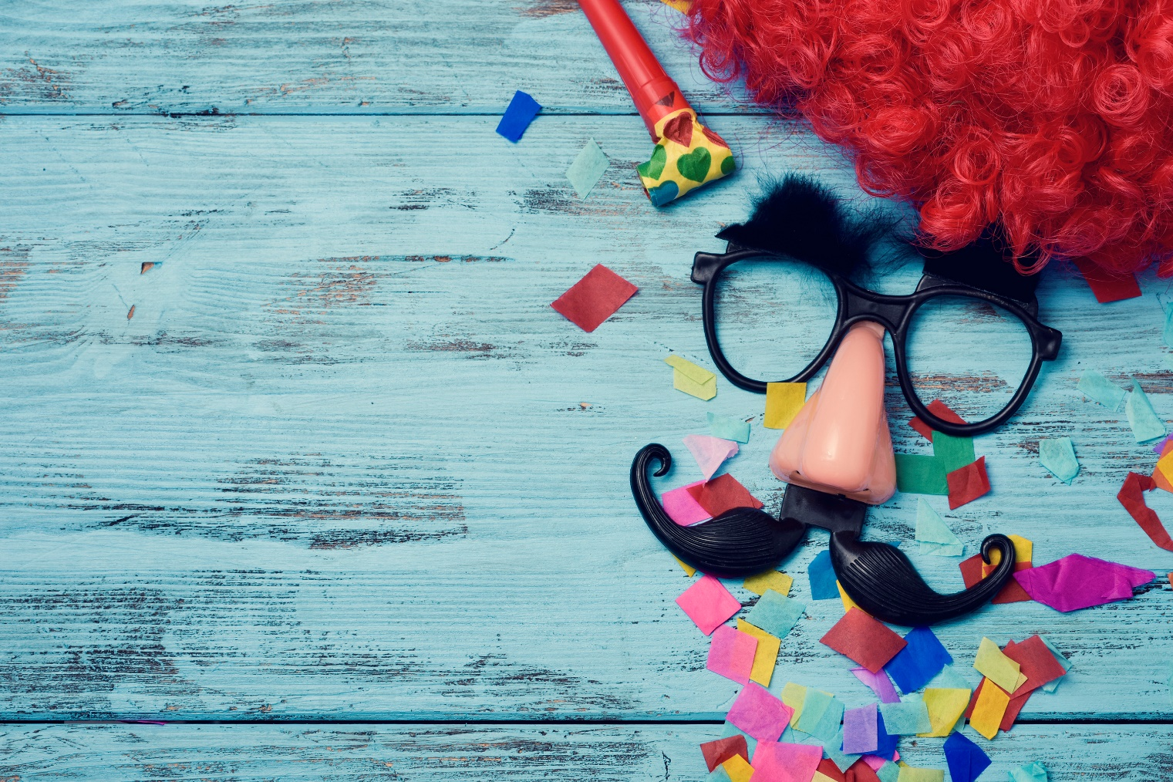
What do you know about carnivals?
Do you know any famous carnivals?
What is a carnival?

Slide 3
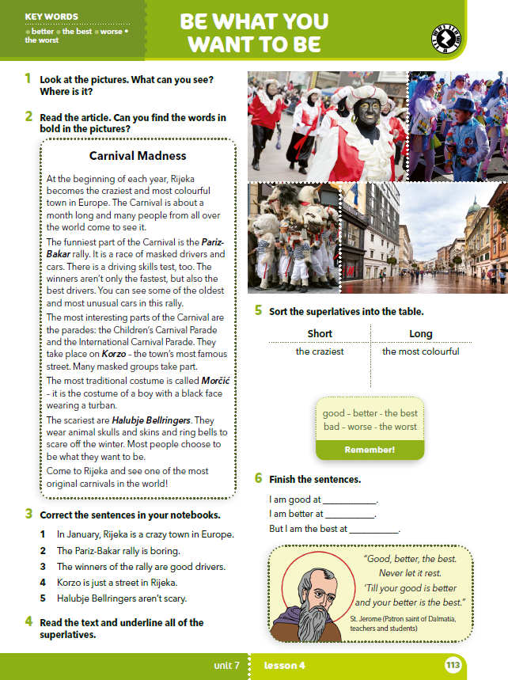
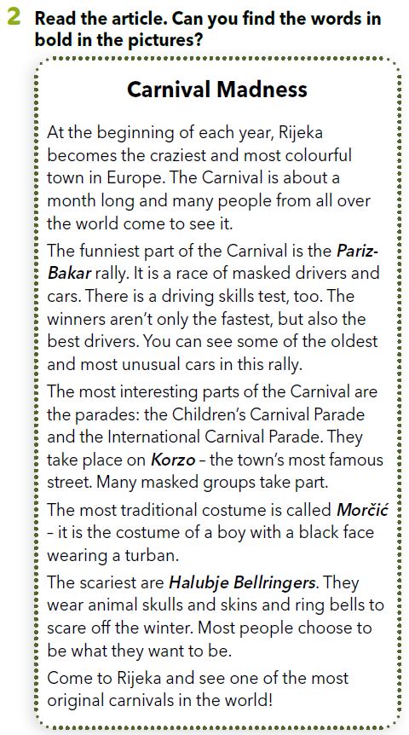
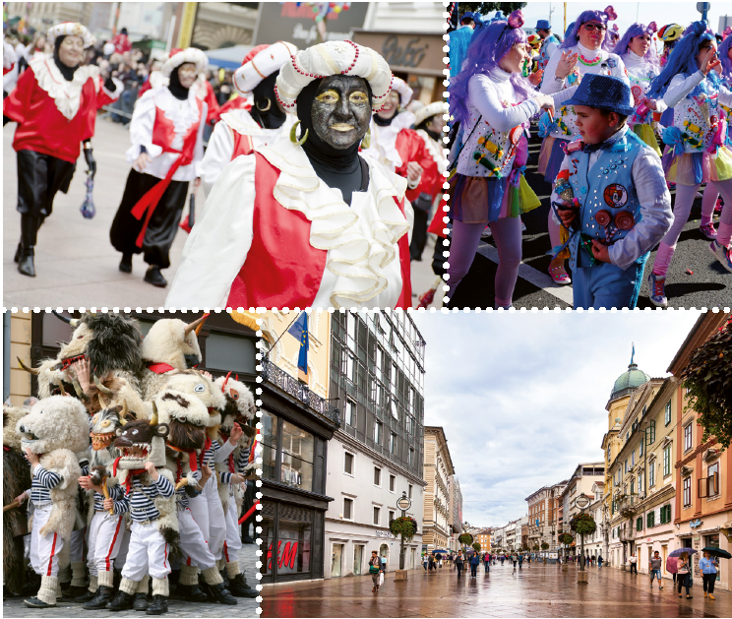
What can you see in the pictures?
Do you recognize the town in the pictures?
Can you name any of the costumes?
What do you think about them?
Morčić
Pariz-Bakar
Korzo
Halubje Bellringers

Slide 4
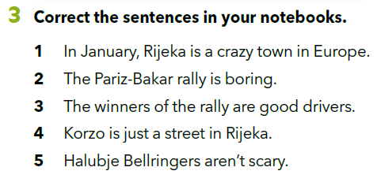
Read the text again and correct the sentences in your notebooks.
1 In January, Rijeka is the craziest town in Europe.
2 The Pariz-Bakar rally is the funniest.
3 The winners of the rally are the best drivers.
4 Korzo is the most famous street in Rijeka.
5 Halubje Bellringers are the scariest.

Slide 5
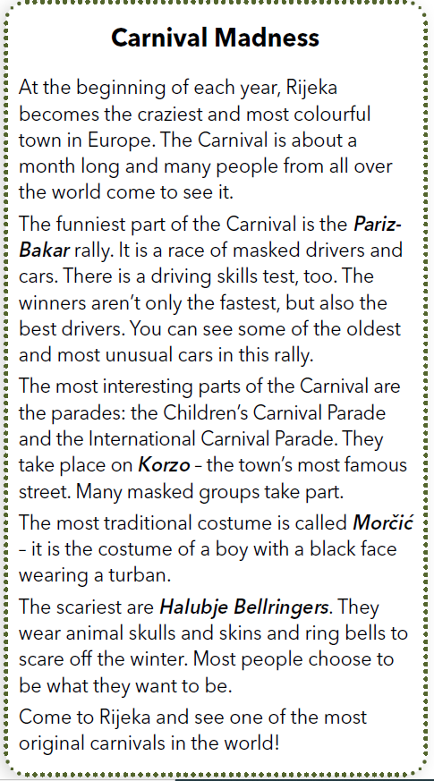

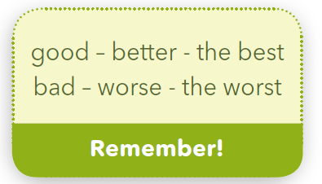
Are all of the superlatives the same?
Which one is different?
The best.
Some adjectives have irregular comparative and superlative.
Neki pridjevi imaju nepravilni komparativ i superlativ.

Slide 6
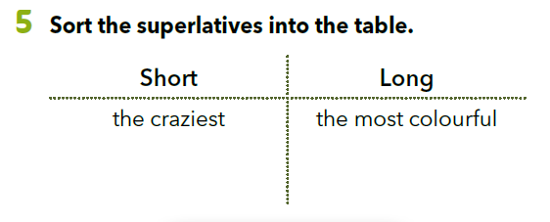
Copy the chart in your notebook.
the funniest
the fastest
the best
the oldest
the scariest
the most colourful
the most unusual
the most interesting
the most famous
the most traditional
the most original

Slide 7
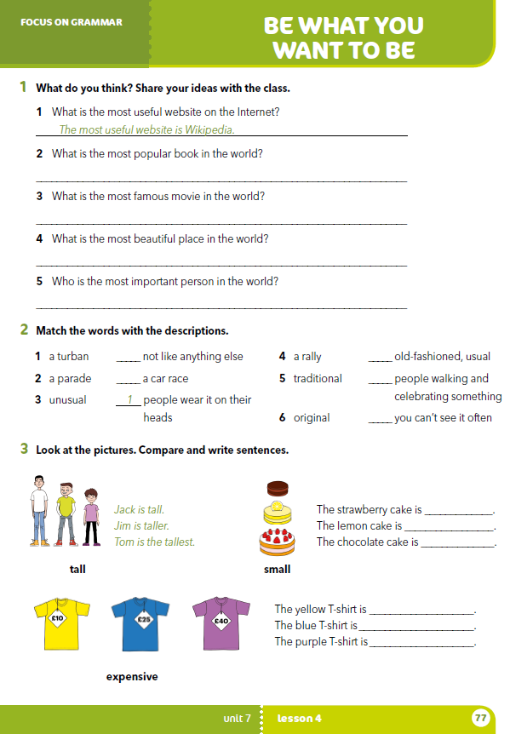
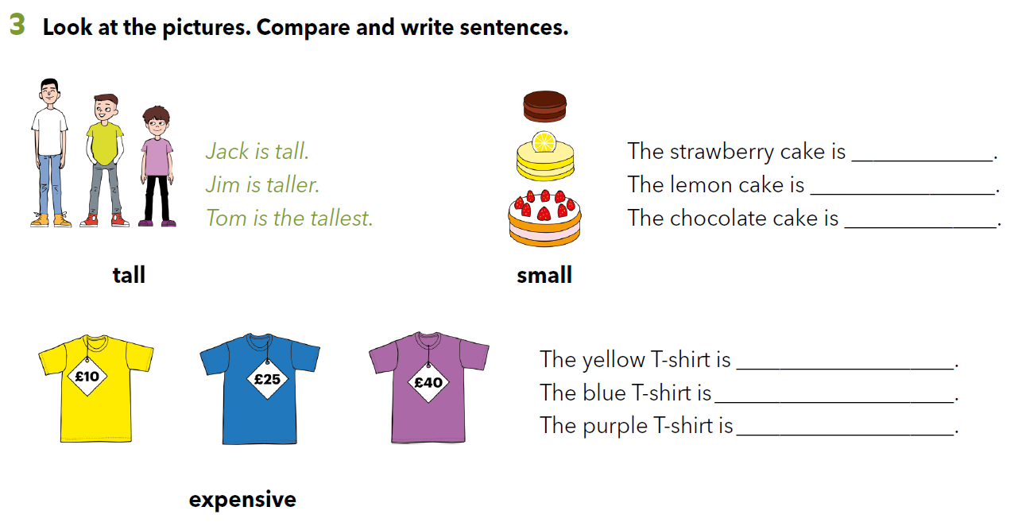
Workbook p. 77
small
smaller
the smallest
expensive
more expensive
the most expensive

Slide 8
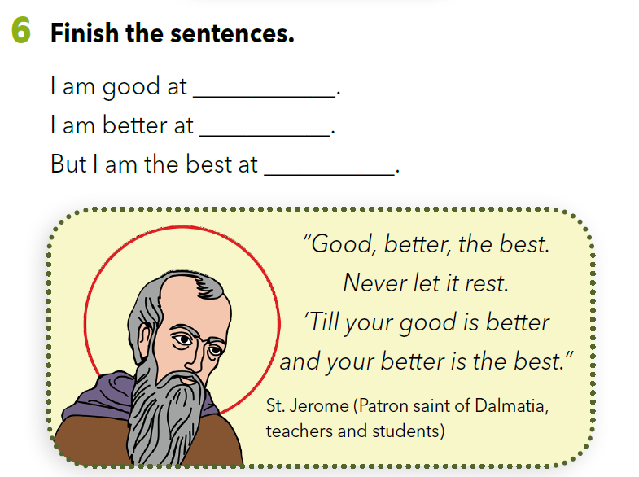

Slide 9
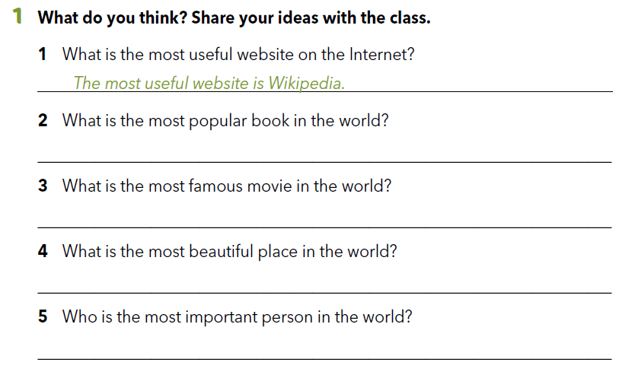
Workbook p. 77

Slide 10
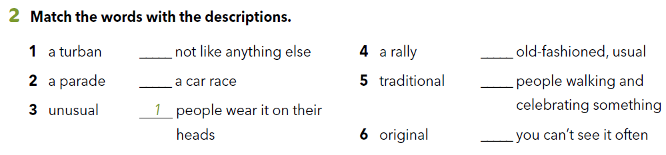
3
5
4
2
6
LET’S REVISE!
Open the following links and complete the tasks.
https://wordwall.net/play/261/545/675
https://learningapps.org/watch?v=pqgghdrb218

